Slide 1

DataRobot
Selling In DataRobot
Xiaolan Li

Slide 2
CONTENT
01
Value of AutoML
02
DataRobot Introdution
03
Feature of DataRobot
04
Example of using

Slide 3
01
Value of AutoML

Slide 4

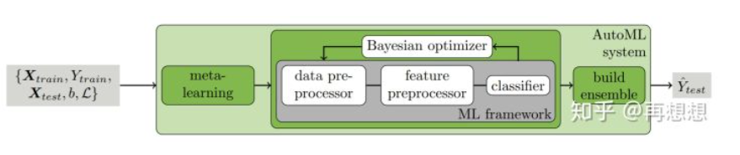
Value of AutoML
Comparison to the
standard approach
The raw data may not be in a form that all algorithms can be applied to it. To make the data amenable for machine learning, an expert may have to apply appropriate data pre-processing, feature engineering, feature extraction, and feature selection methods. After these steps, practitioners must then perform algorithm selection and hyperparameter optimization to maximize the predictive performance of their model. All of these steps induce challenges, accumulating to a significant hurdle to get started with machine learning.
Auto-SKLearn:
Combined Algorithm Selection and Hyperparameter optimization
autosklearn.classification.AutoSklearnClassifier
autosklearn.regression.AutoSklearnRegressor

Slide 5
02
DataRobot Introdution

Slide 6
此处添加标题
Add the title here
DataRobot is an enterprise-grade predictive analysis software for business analysts, data scientists, executives, and IT professionals.
DataRobot leverages the power of automated machine learning. It analyzes numerous innovative machine learning algorithms to establish, implement, and build bespoke predictive models for each situation.
#01 What is DataRobot?
DataRobot Introdution
#02 DataRobot Benefits
It automates and streamlines your modeling lifecycle, enabling you to expediently and easily develop accurate predictive models with little or no coding and machine learning skills. It allows you to implement models with a few clicks to derive true business value in minutes. It offers a comprehensive cloud module powered by the Amazon Web Services (AWS)

Slide 7
03
Feature of DataRobot

Slide 8

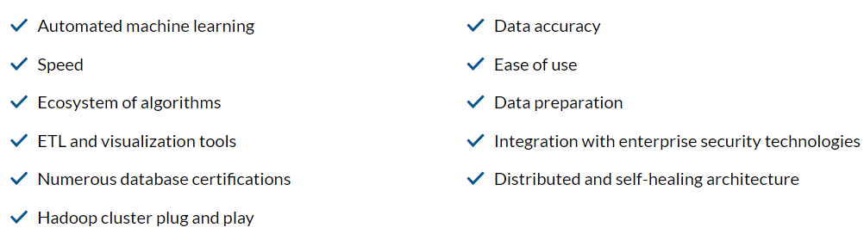
此处添加标题
Add the title here
DataRobot Features

Slide 9
04
Example of using

Slide 10
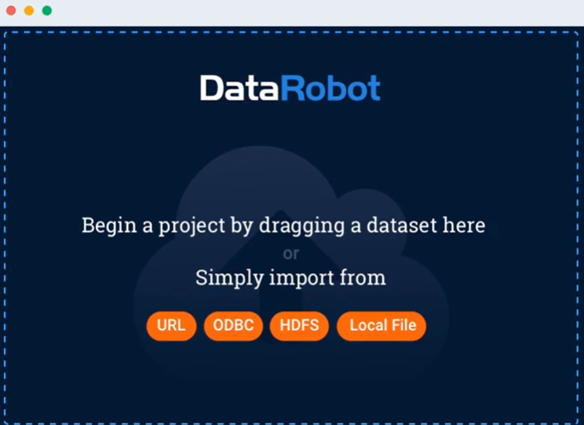
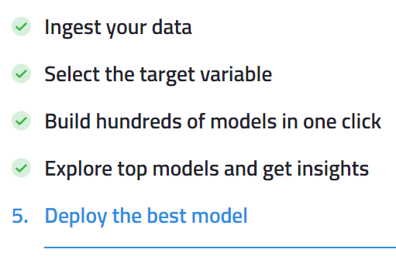
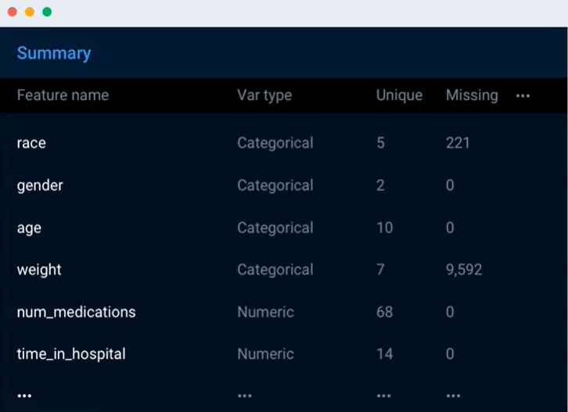
How DataRobot works

Slide 11
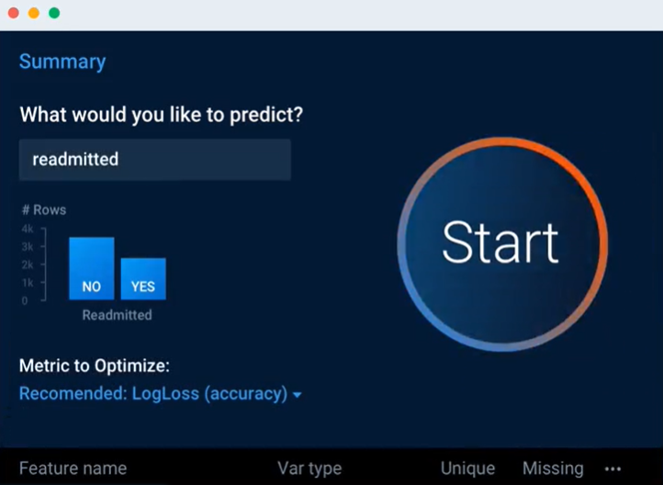
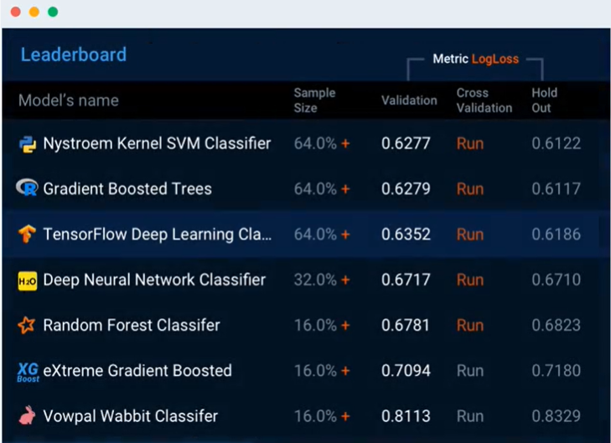
How DataRobot works

Slide 12
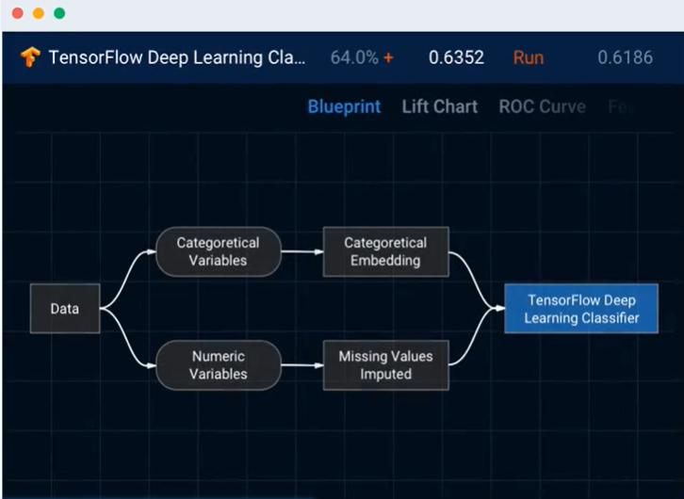
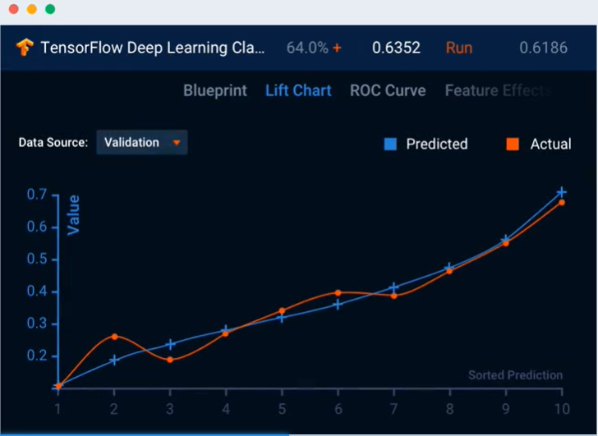
How DataRobot works

Slide 13
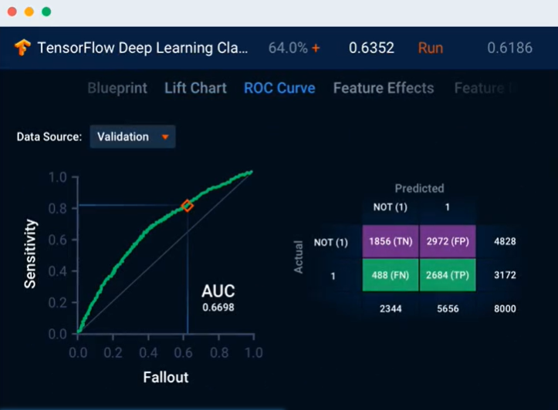
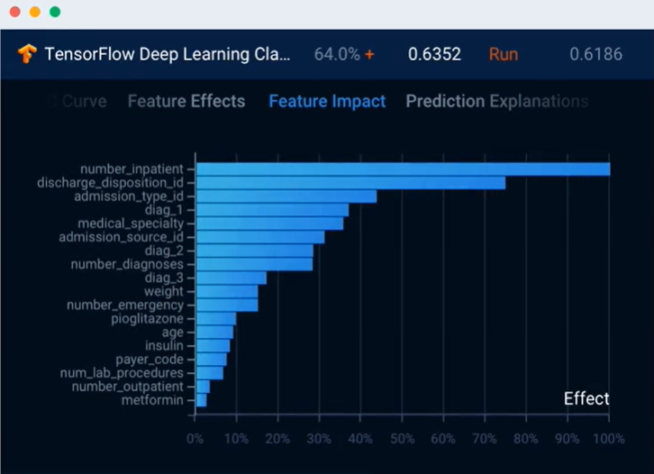
How DataRobot works

Slide 14
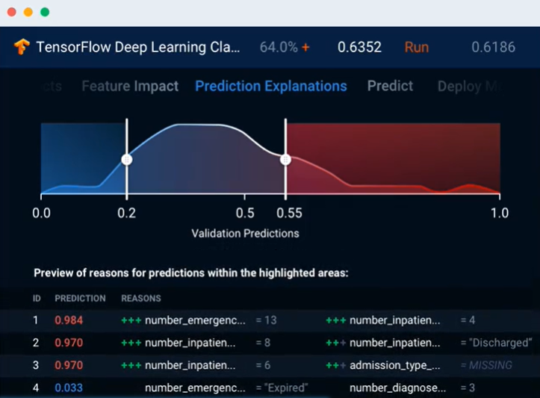
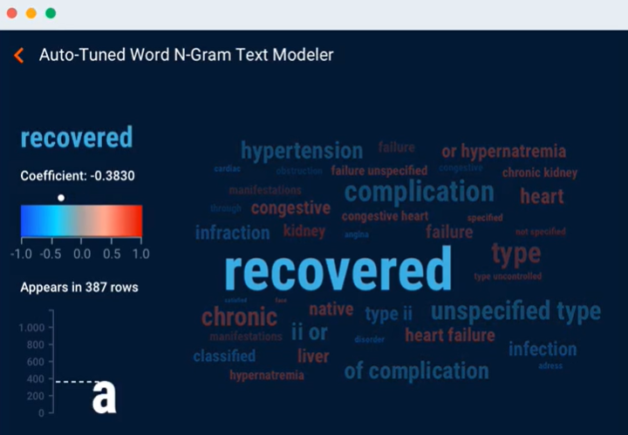
How DataRobot works

Slide 15
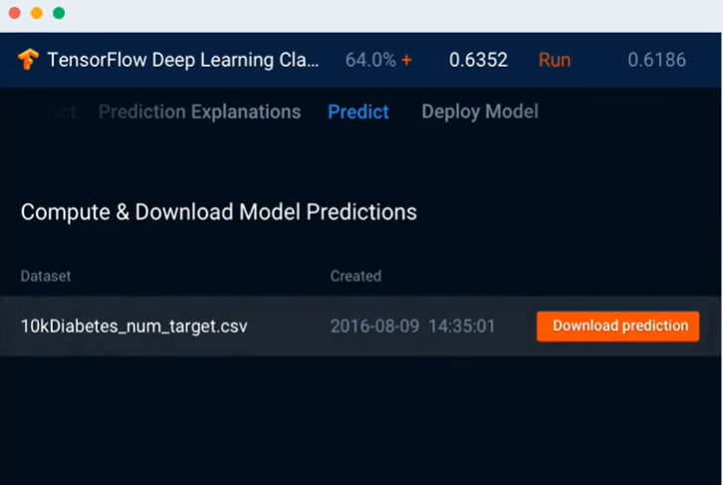
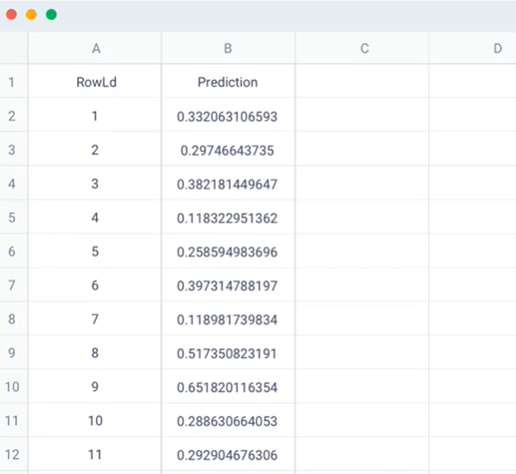
How DataRobot works

Slide 16
DataRobot
Thank you for watching
XIAOLAN LI

